Slide 1

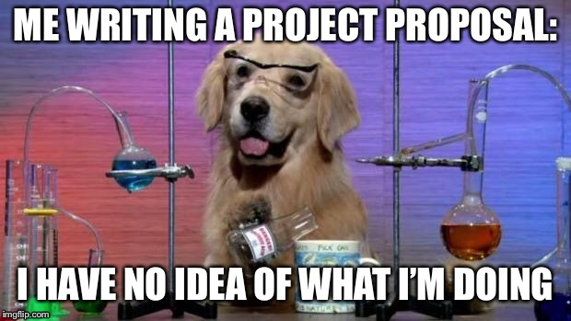
PROJECT PROPOSAL BREAKDOWN
Practicality
What programming languages could you use to solve this project?
Which do you wish to use, why?
Summarise how you wish to implement your solution:
How will you store information?
Text files, database (SQL/Access) & more
What are the key features of your solution?
What will make your project complex?
(see complexity guide on shared)
(see appendix)
Limitations of proposed solution?
Its not meant to be perfect!
Research existing solutions
At least 3 that do something similar or does part of what you wish to do.
A few success criteria to test if your project was successful.
Brainstorm of 3-5 ideas…
Introduction
Summarise what you wish to do
Talk about the client/user
Problem Definition
What problem are you going to solve?
How do you plan to solve it?
Researched the problem in depth identifying and justifying suitable approaches based on research.
Why does the problem require a computed solution?
Stakeholders
Who has an interest in your project?
Client, users, admin/yourself?
Target audience
Identified suitable stakeholders for the project and described them explaining how they will make use of the proposed solution and why it is appropriate to their needs.
Note (no need for real end-user)
Backup
Summarise your backup idea
Problem
Summary
What makes it complex?

Slide 2
Appendix
Likely Complex Problems look like/may include the following ideas:
Permanent Data Storage
Potential for OO Paradigm
Interfacing with hardware
Exporting/Linking with other software
Programs that learn/adapt over time
Games/Physics
Extended Logic Chains
Use of libraries
Use of A Level sorting/searching techniques
Combination of differing technologies
Sharing of data of LAN/WAN
Expert Systems
Simulators
© OCR 2016

